Slide 1

2022
Year 7
Science
Classifications Leaf Lab
By Miss Serafino

Slide 2
Classifications Leaves Lab
Aim
Classify leaves into groups with similar characteristics
Method
Collect pile of mixed leaves for your pair
Identify characteristics of leaves and write these down into your workbooks
Use your notes to classify leaves into groups with similar characteristics

Slide 3
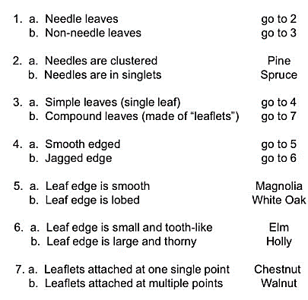
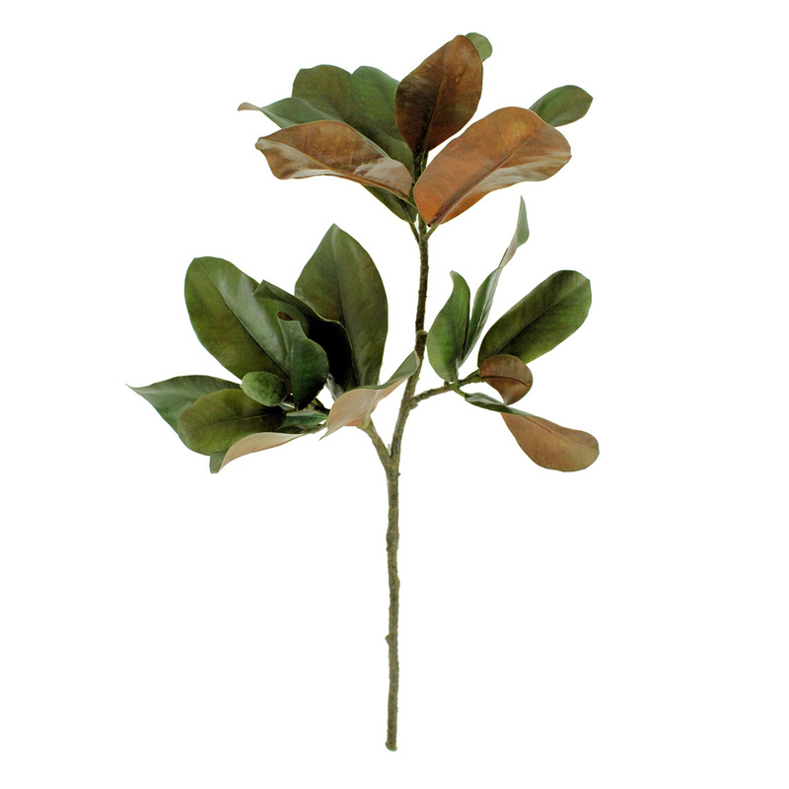
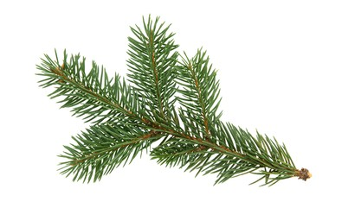
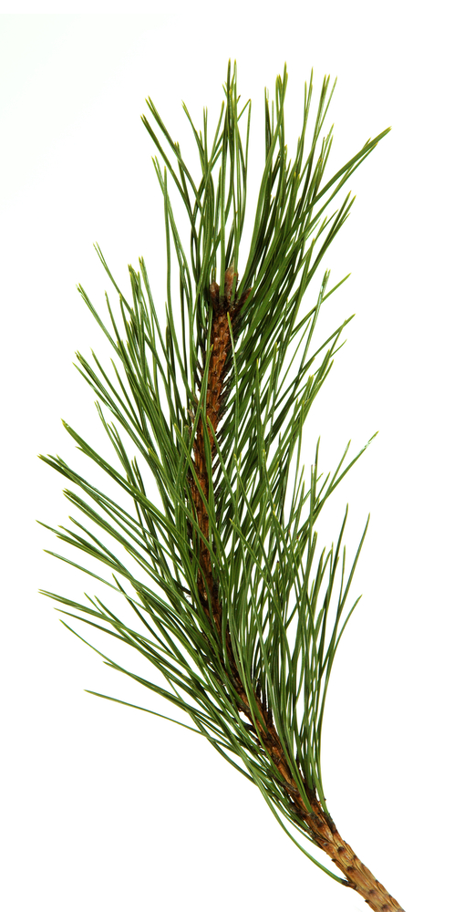
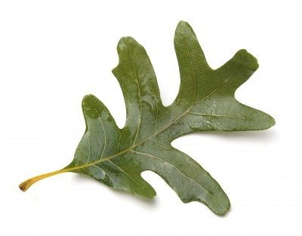
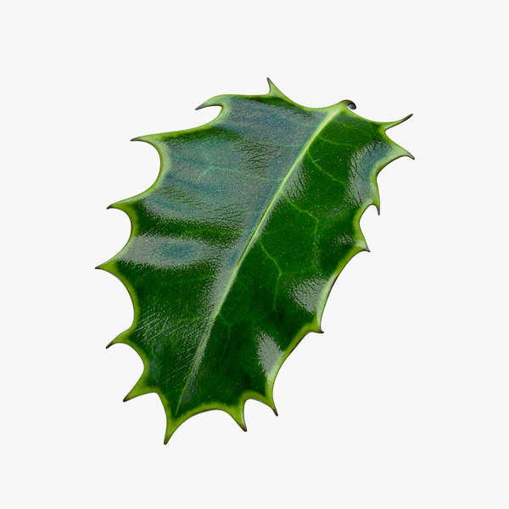

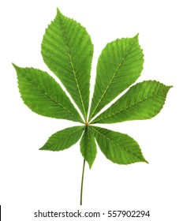
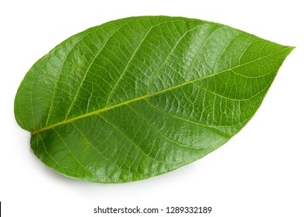
Student Task
Create a tubular key for classification of leaves.

Slide 4
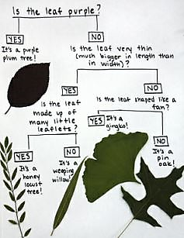
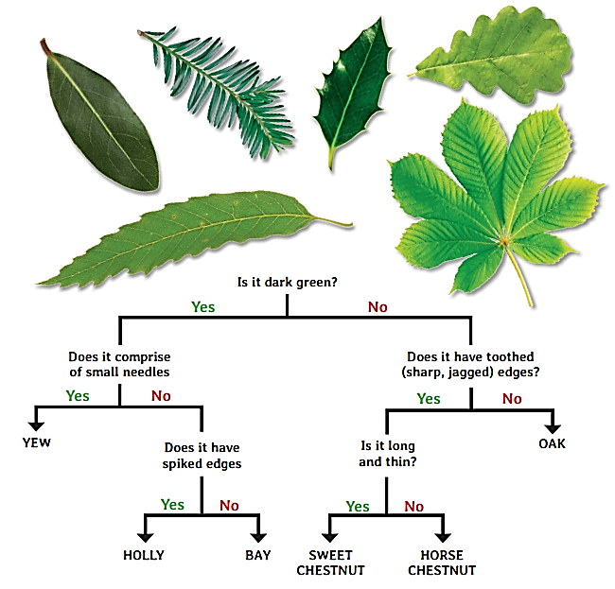
Student Task
Create a dichotomous key for classification of leaves.

